Slide 1
Planning in the Continuous Domain: a Generalized
Belief Space Approach for Autonomous Navigation in
Unknown Environments
Vadim Indelman, Luca Carlone , and Frank Dellaert
International Journal of Robotics Research - 2015
Indelman, V., Carlone, L., and Dellaert, F. (2013). Towards planning in generalized belief space. In Proc. of the Intl. Symp. of Robotics Research (ISRR).
Indelman, V., Carlone, L., and Dellaert, F. (2014). Planning under uncertainty in the continuous domain: a generalized belief space approach. In IEEE Intl. Conf. on Robotics and Automation (ICRA).
Dan and Alon

Slide 2
Itinerary
Introduction
General Belief Space Inference (SLAM)
Planning In the General Belief Space
Formulating Objective Function
Experimental Evaluation
Implementation
Possible Extensions
Notes:
Total (25 min)
Introduction ----------- Dan (1:6) [2 min]
General Belief Space Inference (SLAM) ---------- Alon (7:11) [4 min]
Planning in the General Belief Space ----------- Dan (12:22) [6 min]
Formulating Specific Objective Function -----------Alon (23:29) [6 min]
Experimental Evaluation -----------Dan (30:36) [3 min]
Implementation -----------Alon(37) [1 min]
Possible Extensions -----------Alon(41) [3 min]

Slide 3
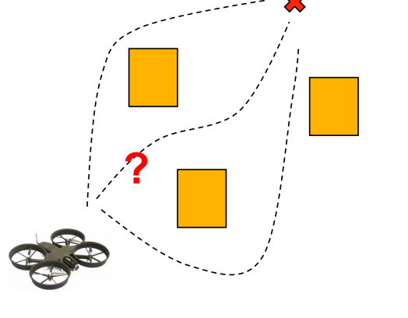
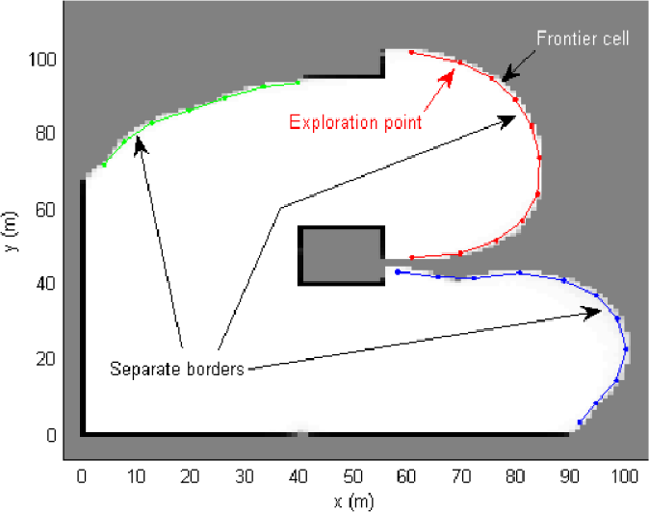
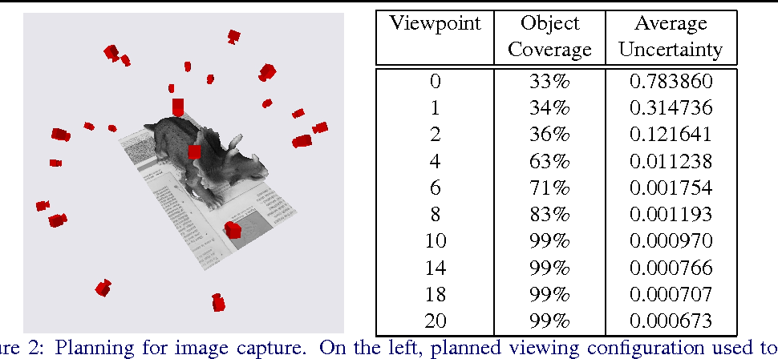
Problem Statement
Formulate a general strategy to accomplish common tasks in robotics in the following setting:
No prior knowledge
Continuous Domain (as opposed to discrete)
Maximum Likelihood Observations
Path Planning
Exploration
Next Best View

Slide 4
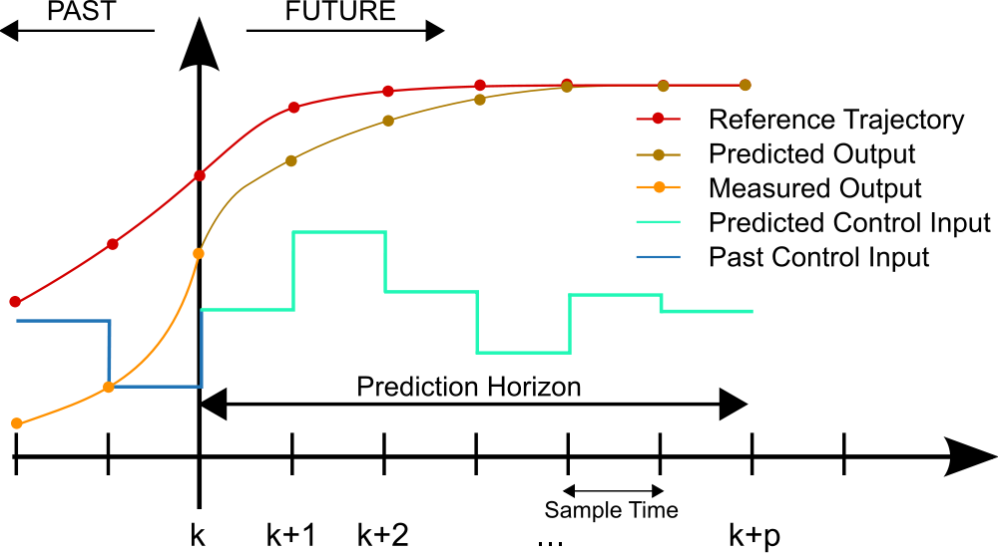
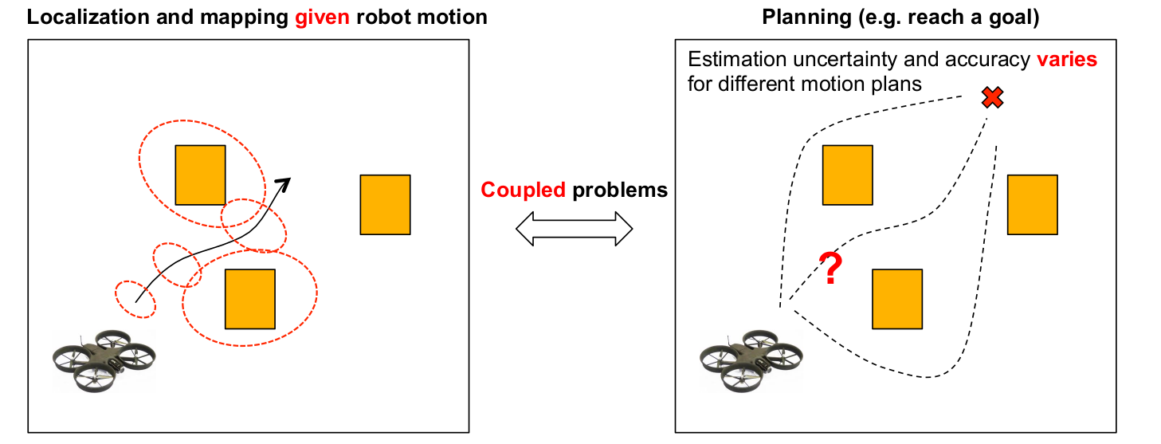
Approach:
Model Predictive Controller
Plan with the Estimation in mind – Reason about future observations

Slide 5
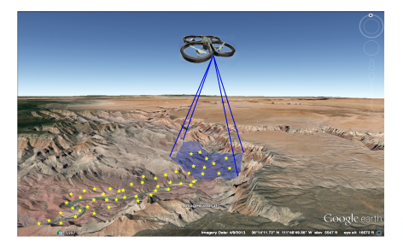
Motivating Example Used:
UAV flies over an unknown region with a camera looking downwards.
Its goal is to reach pre-specified goal positions while preserving an acceptable localization error
Notes:
UAV in an unknown

Slide 6
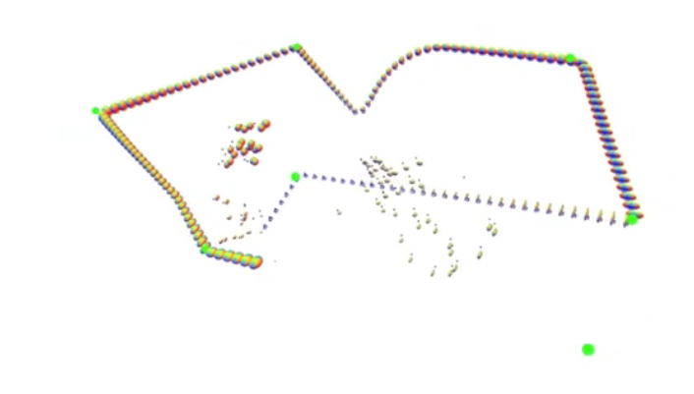

Slide 7
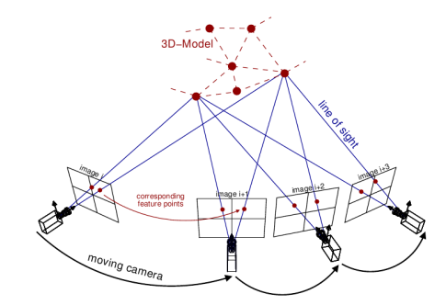
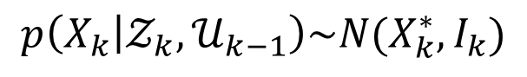
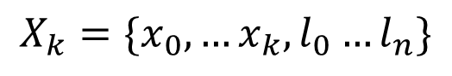
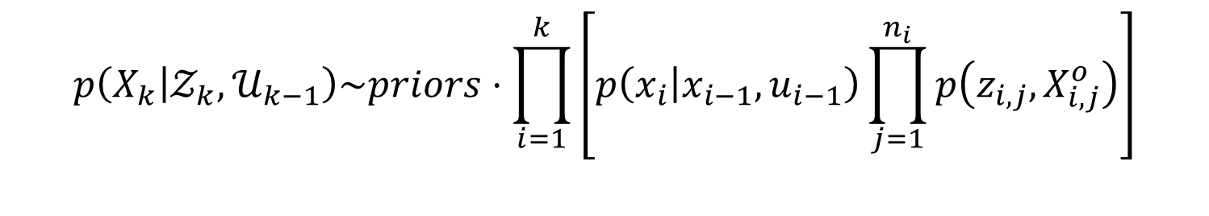
Plan with Estimation in Mind:
As the environment is unknown, a joint state vector is held:
$$X_{k}=\{x_{0},…x_{k},l_{0}…l_{n}\}$$
robot poses
landmarks
Estimation over the joint probability:
$$p\left(X_{k} | 𝒵_{k},𝒰_{k−1}\right)\sim priors⋅\prod_{i=1}^{k}{\left[p\left(x_{i} | x_{i−1},u_{i−1}\right)\prod_{j=1}^{n_{i}}{p\left(z_{i,j},X_{i,j}^{o}\right)}\right]}$$
Motion model
Observation model
Architect models such that the posterior can be modeled as a gaussian:
$$p\left(X_{k} | 𝒵_{k},𝒰_{k−1}\right)\sim N(X_{k}^{∗},I_{k})$$
Information Matrix

Slide 8
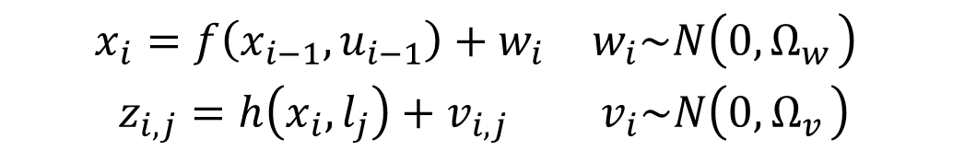
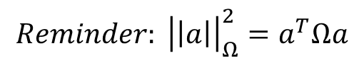
Solving for the posterior distribution via Expectation Maximization:
$$X_{k}^{∗}=\underset{X_{k}}{argmax} p\left(X_{k} | 𝒵_{k},𝒰_{k−1}\right)=\underset{X_{k}}{argmin}\left\{−\log\left(p\left(X_{k} | 𝒵_{k},𝒰_{k−1}\right)\right)\right\}$$
$$\begin{matrix}x_{i}=f\left(x_{i−1},u_{i−1}\right)+w_{i} & w_{i}\sim N\left(0,Ω_{w_{ }}\right) \\ z_{i,j}=h\left(x_{i},l_{j}\right)+v_{i,j} & v_{i}\sim N\left(0,Ω_{v_{ }}\right)\end{matrix}$$
$$X_{K}^{∗}=\underset{X_{k}}{argmin} \left\{{\left|\left|x−{\hat{x}}_{0}\right|\right|}_{Ω_{0}}^{2}+\sum_{i}{\left[{\left|\left|x_{i}−f\left(x_{i−1},u_{i−1}\right)\right|\right|}_{{Ω_{w}}_{i}}^{2}+\sum_{j=ℳ_{i}}{{\left|\left|z_{i,j}−h\left(x_{i},l_{j}\right)\right|\right|}_{{Ω_{v}}_{i,j}}^{2}}\right] }\right\}$$
Prior
Motion Models
Observation models
$$Reminder: {\left|\left|a\right|\right|}_{Ω}^{2}=a^{T}Ωa$$

Slide 9

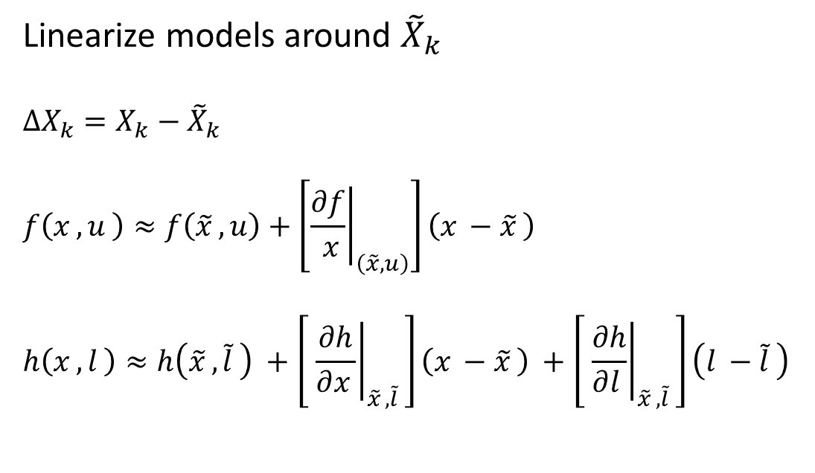
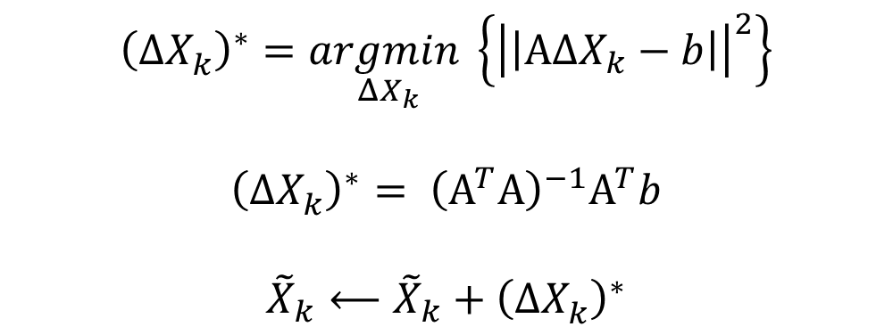
Solving for the posterior distribution via Expectation Maximization:
$$X_{K}^{∗}=\underset{X_{k}}{argmin} \left\{{\left|\left|x_{0}−{\hat{x}}_{0}\right|\right|}_{Ω_{0}}^{2}+\sum_{i}{\left[{\left|\left|x_{i}−f\left(x_{i−1},u_{i−1}\right)\right|\right|}_{{Ω_{w}}_{i}}^{2}+\sum_{j=ℳ_{i}}{{\left|\left|z_{i,j}−h\left(x_{i},l_{j}\right)\right|\right|}_{{Ω_{v}}_{i,j}}^{2}}\right] }\right\}$$
Linearize models around ${\tilde{X}}_{k}$
$$ΔX_{k}=X_{k}−{\tilde{X}}_{k}$$
$$f\left(x_{ },u_{ }\right)≈f\left({\tilde{x}}_{ },u\right)+\left[{\left.\frac{∂f}{ x}\right|}_{\left(\tilde{x}, u\right)}\right]\left(x_{ }−{\tilde{x}}_{ }\right)$$
$$h\left(x_{ },l_{ }\right)≈h\left({\tilde{x}}_{ },{\tilde{l}}_{ }\right) +\left[ {\left.\frac{∂h}{∂x_{ }}\right|}_{{\tilde{x}}_{ },{\tilde{l}}_{ }}\right]\left(x_{ }−{\tilde{x}}_{ }\right) +\left[ {\left.\frac{∂h}{∂l_{ }}\right|}_{{\tilde{x}}_{ },{\tilde{l}}_{ }}\right]\left(l_{ }−{\tilde{l}}_{ }\right)$$
$${\left(ΔX_{k}^{ }\right)}^{∗}=\underset{ΔX_{k}}{argmin}\left\{{\left|\left|ΑΔX_{k}−b\right|\right|}^{2}\right\}$$
$${\left(ΔX_{k}^{ }\right)}^{∗}= {\left(Α^{T}Α\right)}^{−1}Α^{T}b$$
$${\tilde{X}}_{k}⟵{\tilde{X}}_{k}+{\left(ΔX_{k}^{ }\right)}^{∗}$$
Do this until convergence

Slide 10

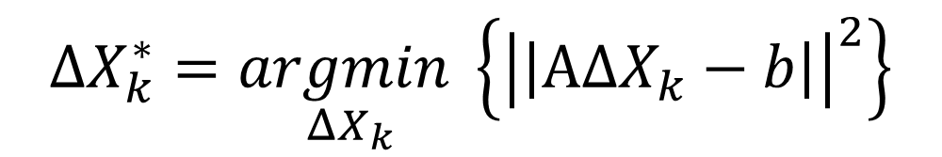
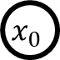
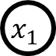
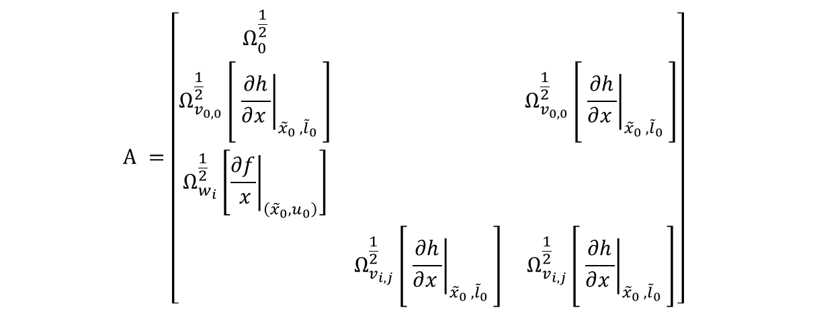
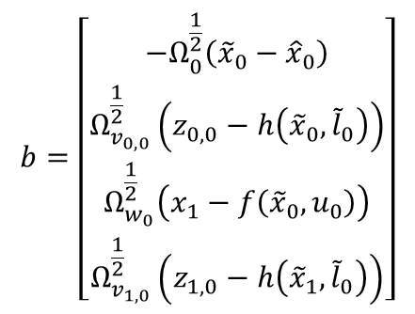
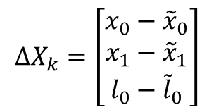
Solving for the posterior distribution via Expectation Maximization:
$$ΔX_{k}^{∗}=\underset{ΔX_{k}}{argmin}\left\{{\left|\left|ΑΔX_{k}−b\right|\right|}^{2}\right\}$$
$$Α =\left[\begin{matrix}Ω_{0}^{\frac{1}{2}} & & \\ Ω_{v_{0,0}}^{\frac{1}{2}}\left[ {\left.\frac{∂h}{∂x_{ }}\right|}_{{{\tilde{x}}_{0}}_{ },{{\tilde{l}}_{0}}_{ }}\right] & & Ω_{v_{0,0}}^{\frac{1}{2}}\left[ {\left.\frac{∂h}{∂x_{ }}\right|}_{{{\tilde{x}}_{0}}_{ },{{\tilde{l}}_{0}}_{ }}\right] \\ Ω_{w_{i}}^{\frac{1}{2}}\left[{\left.\frac{∂f}{ x}\right|}_{\left({\tilde{x}}_{0}, u_{0}\right)}\right] & & \\ & Ω_{v_{i,j}}^{\frac{1}{2}}\left[ {\left.\frac{∂h}{∂x_{ }}\right|}_{{{\tilde{x}}_{0}}_{ },{{\tilde{l}}_{0}}_{ }}\right] & Ω_{v_{i,j}}^{\frac{1}{2}}\left[ {\left.\frac{∂h}{∂x_{ }}\right|}_{{{\tilde{x}}_{0}}_{ },{{\tilde{l}}_{0}}_{ }}\right]\end{matrix}\right]$$
$$b=\left[\begin{matrix}−Ω_{0}^{\frac{1}{2}}\left({\tilde{x}}_{0}−{\hat{x}}_{0}\right) \\ Ω_{v_{0,0}}^{\frac{1}{2}}\left(z_{0,0}−h\left({\tilde{x}}_{0},{\tilde{l}}_{0}\right)\right) \\ Ω_{w_{0}}^{\frac{1}{2}}\left(x_{1}−f\left({\tilde{x}}_{0},u_{0}\right)\right) \\ Ω_{v_{1,0}}^{\frac{1}{2}}\left(z_{1,0}−h\left({\tilde{x}}_{1},{\tilde{l}}_{0}\right)\right)\end{matrix}\right]$$
$$l_{0}$$
$$x_{0}$$
$$x_{1}$$
$$ΔX_{k}=\left[\begin{matrix}x_{0}−{\tilde{x}}_{0} \\ x_{1}−{\tilde{x}}_{1} \\ l_{0}−{\tilde{l}}_{0}\end{matrix}\right]$$
Whitened errors
Whitened Jacobians
Not a function of the measurements (at first iteration)

Slide 11
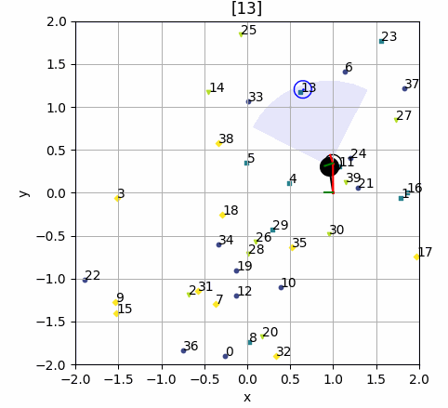
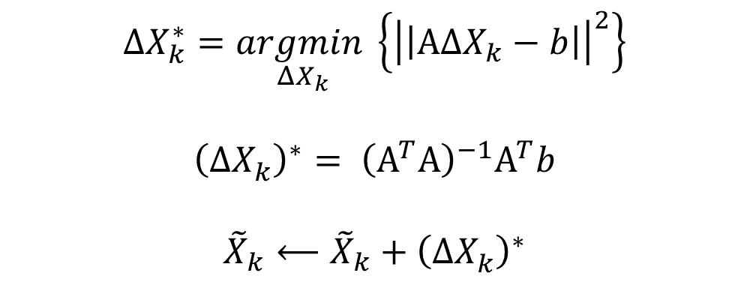
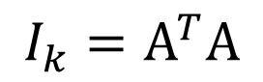
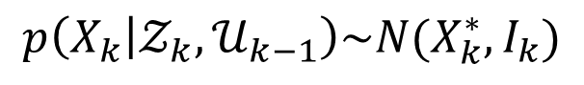
Solving for the posterior distribution via Expectation Maximization:
$$p\left(X_{k} | 𝒵_{k},𝒰_{k−1}\right)\sim N(X_{k}^{∗},I_{k})$$
$$ΔX_{k}^{∗}=\underset{ΔX_{k}}{argmin}\left\{{\left|\left|ΑΔX_{k}−b\right|\right|}^{2}\right\}$$
$${\left(ΔX_{k}^{ }\right)}^{∗}= {\left(Α^{T}Α\right)}^{−1}Α^{T}b$$
$${\tilde{X}}_{k}⟵{\tilde{X}}_{k}+{\left(ΔX_{k}^{ }\right)}^{∗}$$
$$I_{k}=Α^{T}Α$$
Do this until convergence

Slide 12
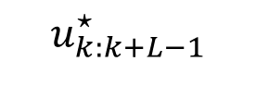
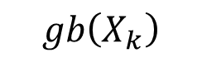
Planning in the Generalized Belief Space
$$gb\left(X_{k}\right)$$
Estimate of future state
$$u_{k:k+L−1}^{⋆}$$
$$gb\left(X_{k}\right)= p\left(X_{k} | 𝒵_{k},𝒰_{k−1}\right)\sim N(X_{k}^{∗},I_{k})$$

Slide 13
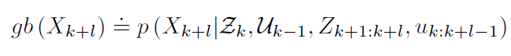
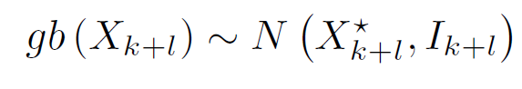
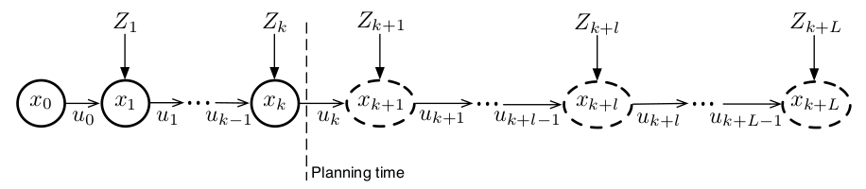
Planning in the Generalized Belief Space
Past
Future

Slide 14
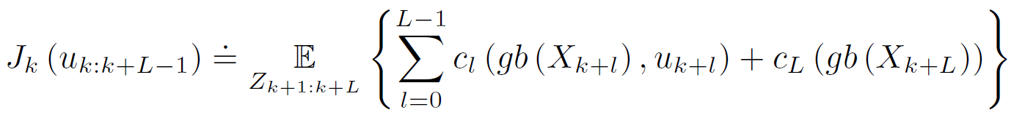
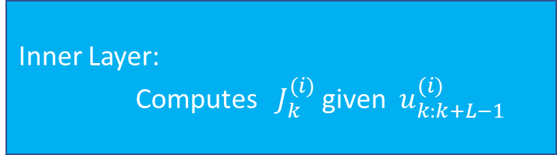

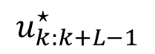
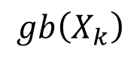
Planning in the Generalized Belief Space
Do this until convergence
Outer Layer: Updates $u_{k:k+L−1}^{(i+1)}$ given $J_{k}^{(i)}$
Inner Layer:
Computes $J_{k}^{(i)}$ given $u_{k:k+L−1}^{(i)}$
$$u_{k:k+L−1}^{⋆}$$
$$gb\left(X_{k}\right)$$
Notes:
Continuous Action Space:
The machine does not involve searching over the action space, but optimizing over it

Slide 15
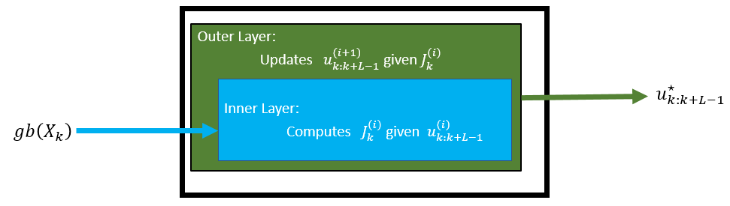
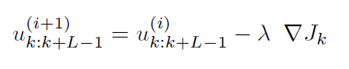
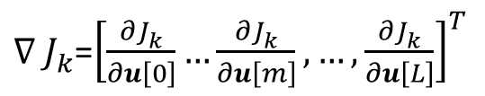

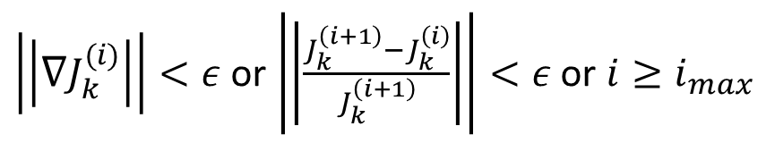
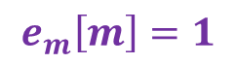
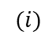
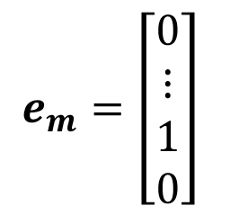
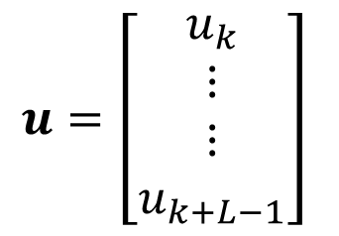
Outer Layer – Inference over the control
Updating via Gradient Decent:
$$(i)$$
Convergence Criteria:
$\left|\left|∇J_{k}^{(i)}\right|\right|<ε$ or $\left|\left|\frac{J_{k}^{\left(i+1\right)}−J_{k}^{\left(i\right)}}{J_{k}^{\left(i+1\right)}}\right|\right|<ε$ or $i≥i_{max}$
Discrete Gradient Computation:
$$\frac{{∂J}_{k}^{ }}{∂u[m]}≈\frac{J_{k}^{ }\left(u+ε⋅e_{m}\right)−J_{k}^{ }\left(u\right)}{ε}$$
$$u=\left[\begin{matrix}u_{k} \\ ⋮ \\ ⋮ \\ u_{k+L−1}\end{matrix}\right]$$
$$e_{m}=\left[\begin{matrix}0 \\ ⋮ \\ 1 \\ 0\end{matrix}\right]$$
$$e_{m}\left[m\right]=1$$
${∇_{ }J}_{k}^{ }$=${\left[\frac{{∂J}_{k}^{ }}{∂u\left[0\right]}…\frac{{∂J}_{k}^{ }}{∂u\left[m\right]},…,\frac{{∂J}_{k}^{ }}{∂u\left[L\right]}\right]}^{T}$
Notes:
(1) The control update is preformed in a continuous domain and can be realized using different optimization techniques. In the paper the method that used is a simple gradient method to compute $u_{k:k+L−1}^{⋆}$.

Slide 16
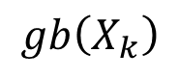

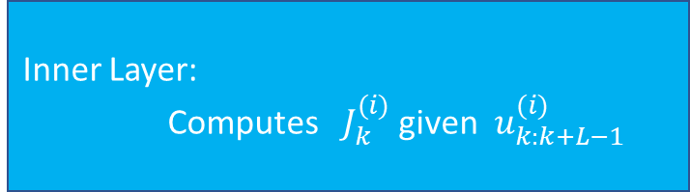
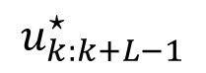
Inner Layer – Inference in GBS
Outer Layer: Updates $u_{k:k+L−1}^{(i+1)}$ given $J_{k}^{(i)}$
Inner Layer:
Computes $J_{k}^{(i)}$ given $u_{k:k+L−1}^{(i)}$
$$u_{k:k+L−1}^{⋆}$$
$$gb\left(X_{k}\right)$$
Past
Future
Notes:
We Now know how to update u from J
No we need to learn how to compute J from u

Slide 17
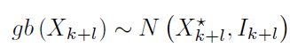

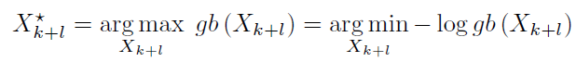
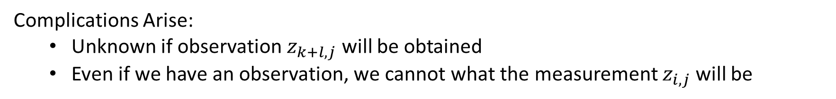
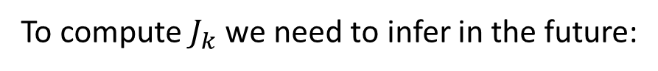
Inner Layer – Inference in GBS
To compute $J_{k}$ we need to infer in the future:
Expectation Maximization
Complications Arise:
Unknown if observation $z_{k+l,j}$ will be obtained
Even if we have an observation, we cannot what the measurement $z_{i,j}$ will be
Notes:
The inner layer involve the computation of the Gaussian approximation of:
Whose mean value coincides with the MAP estimate of:

Slide 18
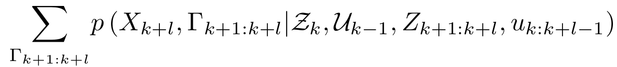

Inner Layer – Inference in GBS
$$\underset{marginlization}{=}$$
Binary variable for each future observation (Acquired/Not Acquired)
Expectation Maximization
$$X_{k+l}^{⋆}=\underset{X_{k+l}}{argmin} \{−\log\left(gb\left(X_{k+l}\right)\right\}=\underset{X_{k+l}}{argmin} \left\{−\log\left(\sum_{Γ_{k+1:k+l}}{p\left(X_{k+l},Γ_{k+1:k+l}|Z_{k},U_{k−1},Z_{k−1:k+l},u_{k:k+l−1}\right)}\right)\right\}$$
(*Minka,1998)
Notes:
Minka 1998 promises that this EM convergences to a local minimum of the cost

Slide 19


Inner Layer – Inference in GBS
Prior
Motion model
Observation models
Conditioning
Notes:
Finish slide with saying that we need to plug in the models and then we get -> next slide

Slide 20



Inner Layer – Inference in GBS

Slide 21





Inner Layer – Inference in GBS
$$X_{k}^{⋆}$$
$${\overline{x}}_{k+1}$$
Same process but with Whitened Jacobians
$${\overline{x}}_{k+2}$$
$${\overline{I}}_{k+l}$$
Also serves as linearization point
Notes:
If “solving” EM without future measurements, we can find I_kpl_Bar

Slide 22


Slide 23

A specific Family of Objective Functions
Penalizes last pose uncertainty
penalizes control effort
Penalizes last pose distance from goal
Penalizes last pose uncertainty
$M_{u},M_{Σ},M_{x}$ - Weight Matrices
$E_{k+L}^{G}, M_{Σ}$ - Selection Matrices
Simple change to minimize map uncertainty

Slide 24



A specific Family of Objective Functions
Not a function measurements under 1 Newton-Gauss Iteration
Not a function of measurements
$$I_{k}=A^{T}A$$
From term $\underset{Z_{k+1:k+L}}{𝔼}{\left|\left|E_{k+L}^{G}X_{k+L}^{⋆}−X^{G}\right|\right|}_{M_{x}}^{2}$

Slide 25



A specific Family of Objective Functions
Falls if assuming maximum likelihood measurements (proof in appendix)
Contains the matrix $I_{k+L}^{−1}$ which stems from EM with future measurements
$→$ Rewards loop closures

Slide 26



Choice of $M_{u}$
Larger $M_{u}$ minimizes control efforts.
smaller control efforts $→$ less torque applied to turn
Notes:
The lar

Slide 27





Choice of $M_{x}$ and $M_{Σ}$
Selection Matrix
Selection Matrix

Slide 28



Choice of $M_{x}$ and $M_{Σ}$
$α_{k}$ can’t be bigger than 1

Slide 29




Choice of $M_{x}$ and $M_{Σ}$
Naïve approach to choose$α_{k}$
Proposed method for $α_{k}$

Slide 30



Implementation via GTSAM
Experimental Evaluation
Uniform
Oasis
Clusters
Statistical Study (Uniform)
Different Planning Horizons (clusters)
Comparison to related work

Slide 31

Statistical Study in “Uniform” Environment
30 runs with different noise realizations
Smooth trajectories
Similar loop closure events (pose Index == 100)
Estimation errors are below the square root covariance trace, showing inference is consistent

Slide 32


Experimental Evaluation – Horizon Length
Longer horizon makes for better planning but with a significant cost to computation time

Slide 33








Experimental Evaluation – Method Comparison
$$β≈{69}^{2}\left[m^{2}\right]$$
$$L=5$$
$$M_{u}=0.1$$
$$α_{LB}=0.6$$
$$GBS$$
$$GBS−ML$$
$$CNU$$
$$DP$$
Notes:
CNU – Continuous Planning no uncertainty
DP - Discrete Planning:
Selects a set of waypoints that corresponds to a potential loop closure location and calculates a path using global Astar.
Uses a heuristic to reward nodes where the robot is likely to reobserve landmarks
Uses cost with two contrasting objectives: minimizing uncertainty and exploring new areas

Slide 34

Experimental Evaluation - Uniform
CNU goes in straight lines and ignores uncertainty (expected)
CNU produces the largest estimation error (expected)
GBS and GBS-ML are very similar in performance
Planning time in GBS and GBS-ML increase when turns are required (more iterations in gradient decent)
Discrete approach is also able to produce plan that satisfies soft uncertainty
Discrete approach control effort is a-lot more significant (‘zig zag’ actions)

Slide 35

Experimental Evaluation - Oasis
Summarization:
CNU is ‘cheap’ but produces large estimation error
GBS and GBS-ML are very similar in performance
GBS and GBS-ML computations increase when turning
Discrete approach has high control effort

Slide 36

Experimental Evaluation - Clusters
Summarization:
CNU is ‘cheap’ but produces large estimation error
GBS and GBS-ML are very similar in performance
GBS and GBS-ML computations increase when turning
Discrete approach has high control effort

Slide 37


Parameter List
$ϕ$ – robot FOV
$r$ – robot range
$Σ_{w}$– motion covariance
$Σ_{v}$ – measurement covariance
$ϵ$ – gradient decent eps
$λ$ – gradient decent learning rate
$i_{max}$ - gradient decent max iterations
$M_{u}$- control effort weight
$β$ – covariance limit
$α_{LB}$ - logic controller
<default isam2 parameters>

Slide 38





Deliberation and Possible Extensions - Weights
Assumptions:
Myopic setting
Linear motion model: $x_{k+1}=x_{k}+u_{k}$
$ζ\left(u_{k}\right)=u_{k}−{\overline{u}}_{k}$
$M_{u}=γI_{3}$
Notes:
Due to quadratic cost:
we apply very strong control actions (arbitrarily neglecting the nominal control, while, close to the goal, we apply weak control and we
mainly follow the nominal control)
Weighting quadratic costs is difficult and was handled via a changing alpha value.
We can also:
Set waypoints to make the term Xg-Xk constant
Use l1 norm instead of Euclidian norm for distances (removes the dependence of the control action on the distance to the goal but is not differentiable at the origin and yada yada)

Slide 39


Deliberation and Possible Extensions – Loopy Solutions
Sometimes a goal is just out of reach….
Dynamically relax $β$?

Slide 40


Deliberation and Possible Extensions – Hard constraints
(1)
(2)
Notes:
Instead of penalizing violation from the bounds, make sure in a hard constraint that we don’t violate. This will guarantee that we don’t “skew”
When x -> 0 log(x) -> -inf making the cost basically inf.

Slide 41





Deliberation and Possible Extensions – Other ideas
Obstacle Avoidance
Efficiency:
Smarter numerical optimization
than vanila gradient decent
Exact Differentials with Lie Algebra
Smart Initialization
Earlier actions have more effect. Optimize less on later actions
$$u_{k:k+L−1}^{(0)}$$
$$V=\int{\frac{Σf}{m}dt}$$
Adaptive horizon length
Simplifications
Notes:
Adaptive Horizon length: Check distance to goal before deciding
Simplifications: (image from khen Elimelech and Vadim “Simplified decision making in the belief space using belief sparsification”
Solver
Cluster of landmarks -> one landmark

